Slide 1

Project 1: An analysis of crime in Chicago in comparison to income and access to public healthcare facilities
Presented by Ben Belczak, Molly Delehant, Joseph DeVito, Matthew Hill, and Maryam Shaaban

Slide 2
Questions
Do areas with increased crime rates experience restricted access to public healthcare facilities?
Do areas with lower MHI (Median Household Income) experience restricted access to public healthcare facilities?
Are areas with higher arrest rates linked to MHI (Median Household Income)?

Slide 3
Data
Crime data (City of Chicago Data Portal, “Crimes 2001 to Present”)
Primary care community health facility locations (City of Chicago Data Portal, “Public Health Services- Chicago Primary Care Community Health Centers”)
Mental health, STI, and WIC clinic locations (City of Chicago Data Portal, “Chicago Department of Public Health Clinic Locations”)
Income data by community area (Chicago Magazine The Geography of Money)
Community area boundaries (City of Chicago Data Portal, “Boundaries- Community Areas (current)”

Slide 4

Hypothesis 1
Null: There will be no correlation between the number of public healthcare facilities in a community area and the amount of crime experienced in a community area
Alternative: There will be a negative correlation between the number of public healthcare facilities in a community area and the amount of crime experienced in a community area

Slide 5
Hypothesis 2
Null: There will be no correlation between the average median household income of a community area and the number of public healthcare facilities in a community area
Alternative: There will be a positive correlation between the average median household income of a community area and the number of public healthcare facilities in a community area

Slide 6
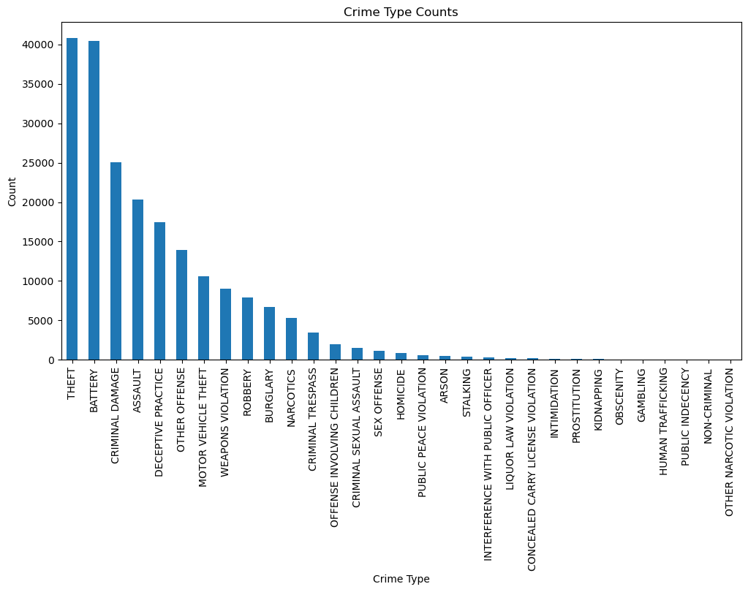
Bar Graph: Crime Incidents by Crime Type in Chicago

Slide 7
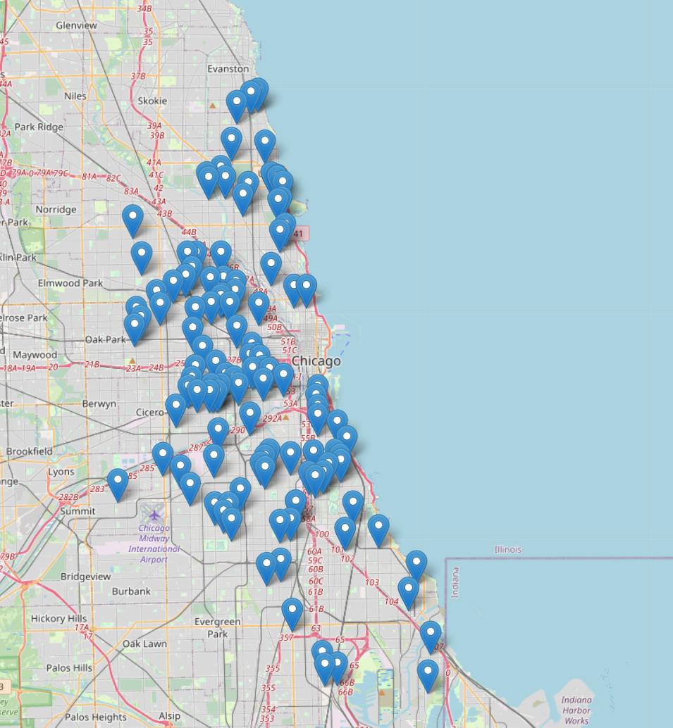
Map: Primary Care Community Health Facilities in Chicago

Slide 8
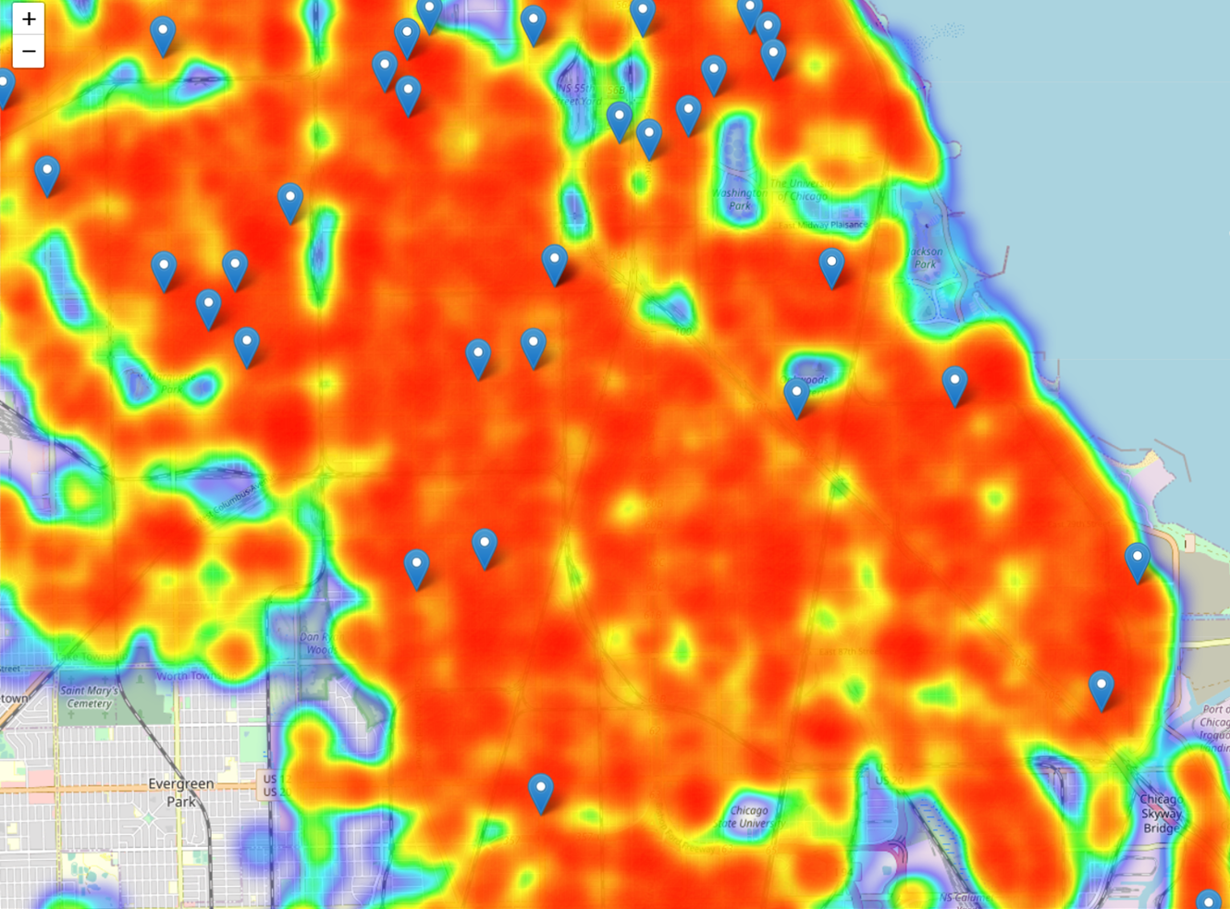
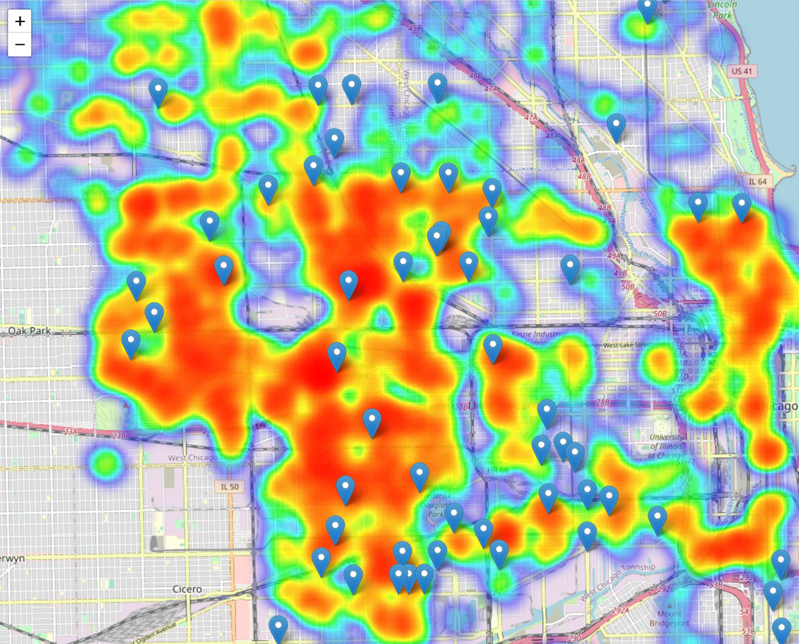
Heat Map: Crime incidents vs. primary care community health facility locations
Assault Crimes in South Chicago
Narcotics Crimes in South West Chicago

Slide 9



What about other public healthcare centers?

Slide 10
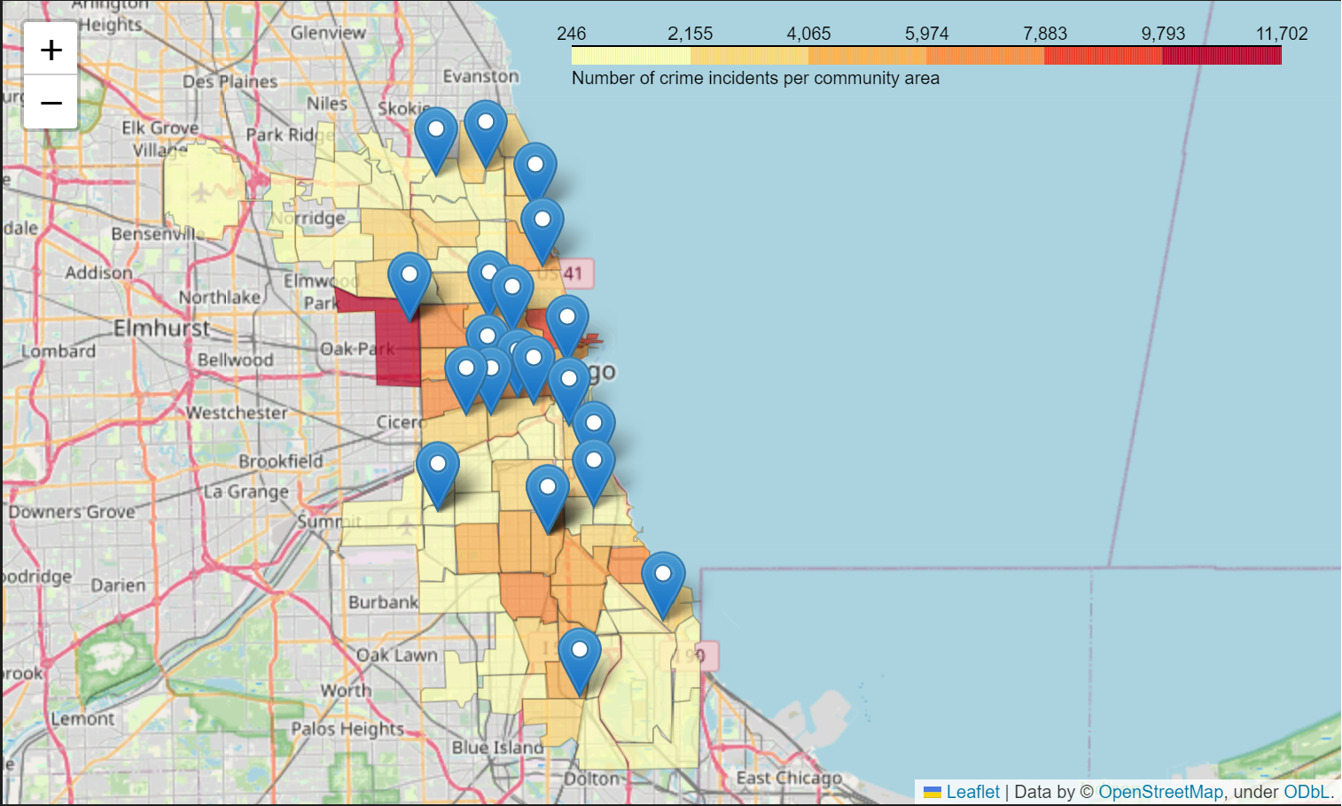
Choropleth Map: Crime by community area vs. clinic locations

Slide 11
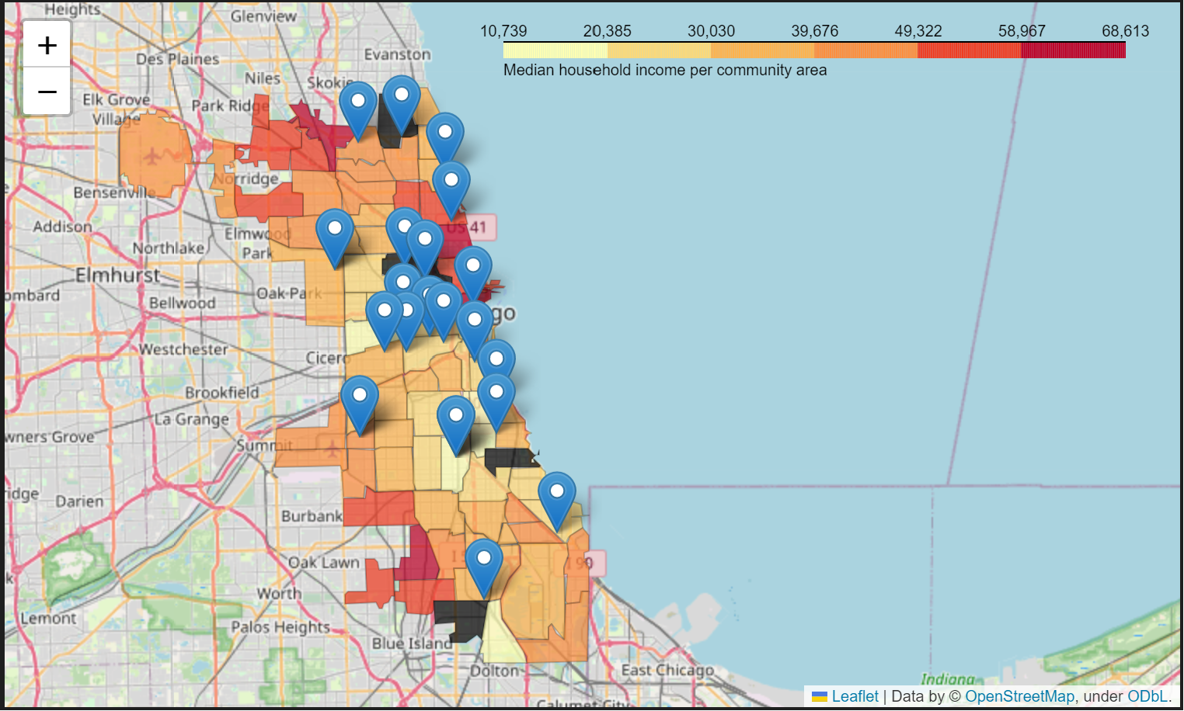
Choropleth Map: Income by community area vs. clinic locations

Slide 12
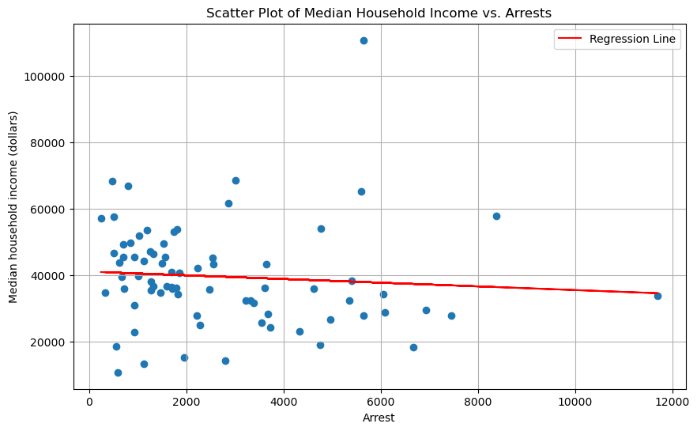
Scatter Plot:
Total Arrests V.S
Median Income
r_value = -0.07958
p_value = 0.49729

Slide 13
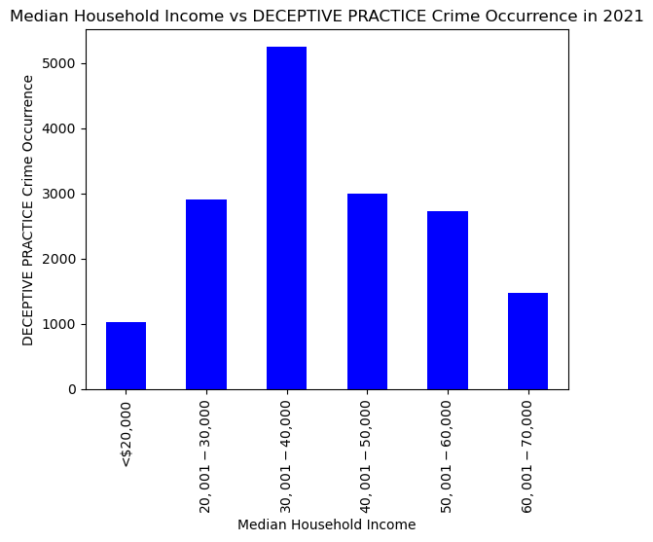
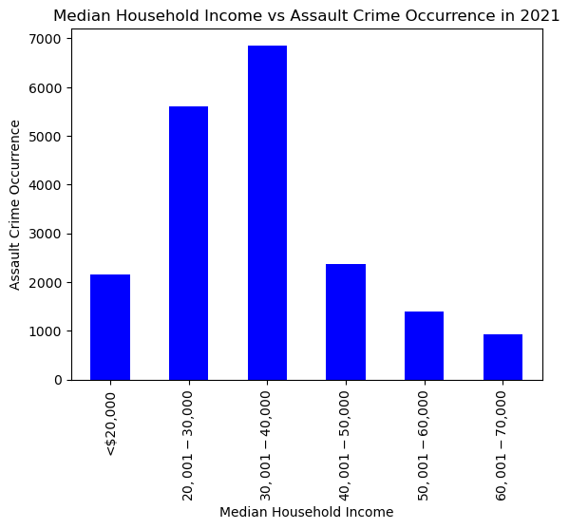
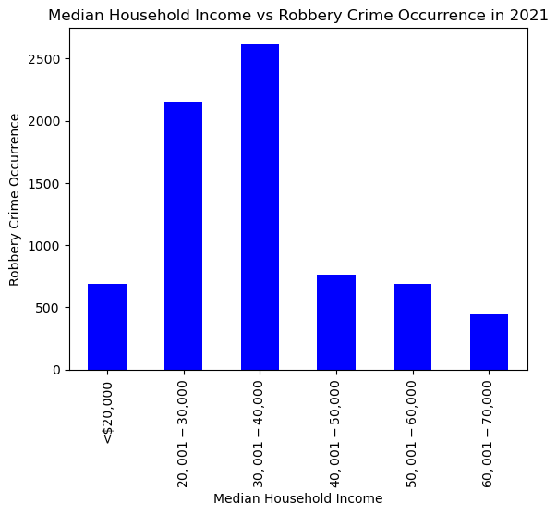
Chicago Median Household Income had an effect on Assault and Robbery but no effect on Deceptive Practices
F-statistic=1.7624, p-Value=0.1323
F-statistics=4.2262, p-Value=0.0020992
F-statistic=3.4887, p-Value=0.0072

Slide 14
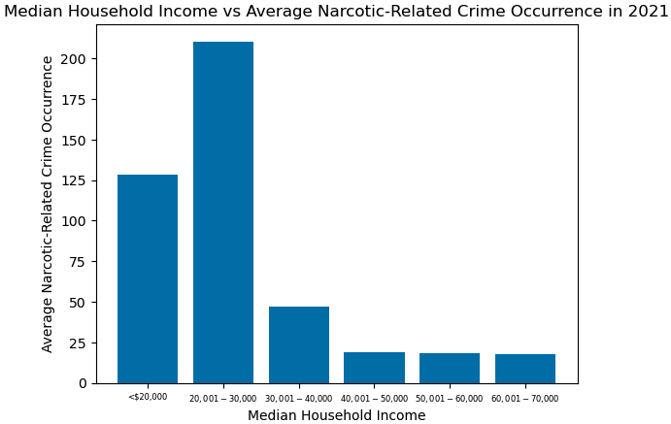
Chicago Median Household Income had an effect on the average amount of narcotics-related crime in 2021
F-Statistic: 3.087439879976972
p-Value: 0.014513067316189936

Slide 15
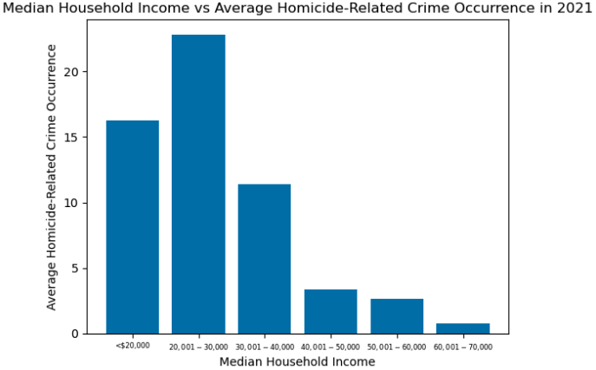
Chicago Median Household Income had an effect on the average amount of homicide-related crime in 2021
F-Statistic: 4.9897228091400665
p-Value: 0.0006165607406226868

Slide 16
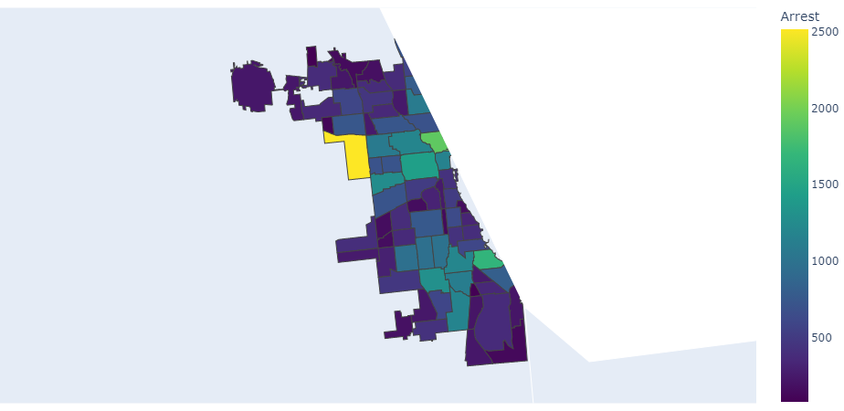
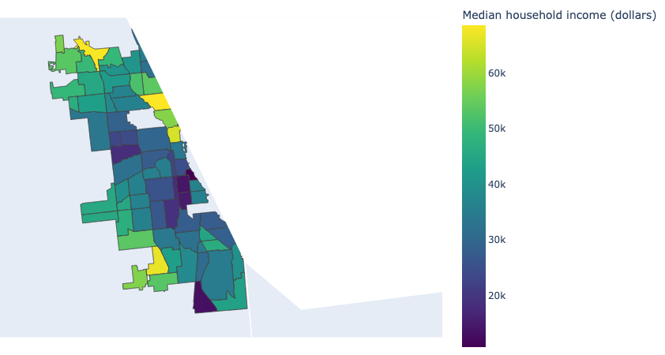
Choropleth Maps representing the relationship between median household income and the number of arrests per community area

Slide 17
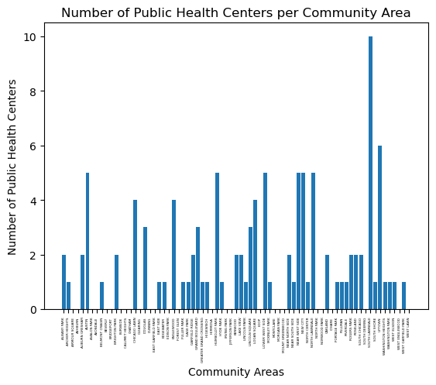
Bar Graph: Number of Public Health Centers per Community Area

Slide 18
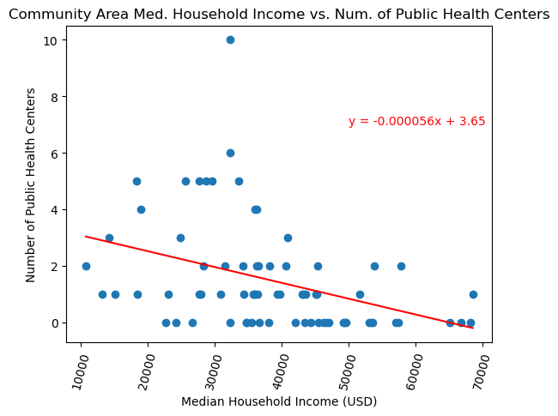
Scatterplot: Median Household Income per Community Area vs. Number of Public Health Centers per Community Area
r-value = -0.38378044421926105
p-value = 0.0008029943949910598

Slide 19
Conclusions
We fail to reject the null hypothesis that there is no correlation between median household income and number of arrests in the year 2021, according to our data sets. However, when you breakdown arrests to specific kinds of crime a correlation does appear depending on the crime.
We reject the null hypothesis that there is no correlation between the median household income of a community area and the number of public health centers in a community area. However, the correlation shows that there is a negative correlation between the median household income of a community area and the number of public health centers in the community areas.

Slide 20
Limitations
Relying on Census-sourced data--Could be more up-to-date and current
Facility and clinic location data are from 2019 and 2017 respectively-- While this is not too out-of -date, there could be new locations not accounted for or closures in existing locations that we are unaware of.
In choropleth crime map, could be more effective to visualize crime as ‘crime per capita’ or ‘count per 1,000 population’ instead of ‘total crime incidents’

